Slide 1
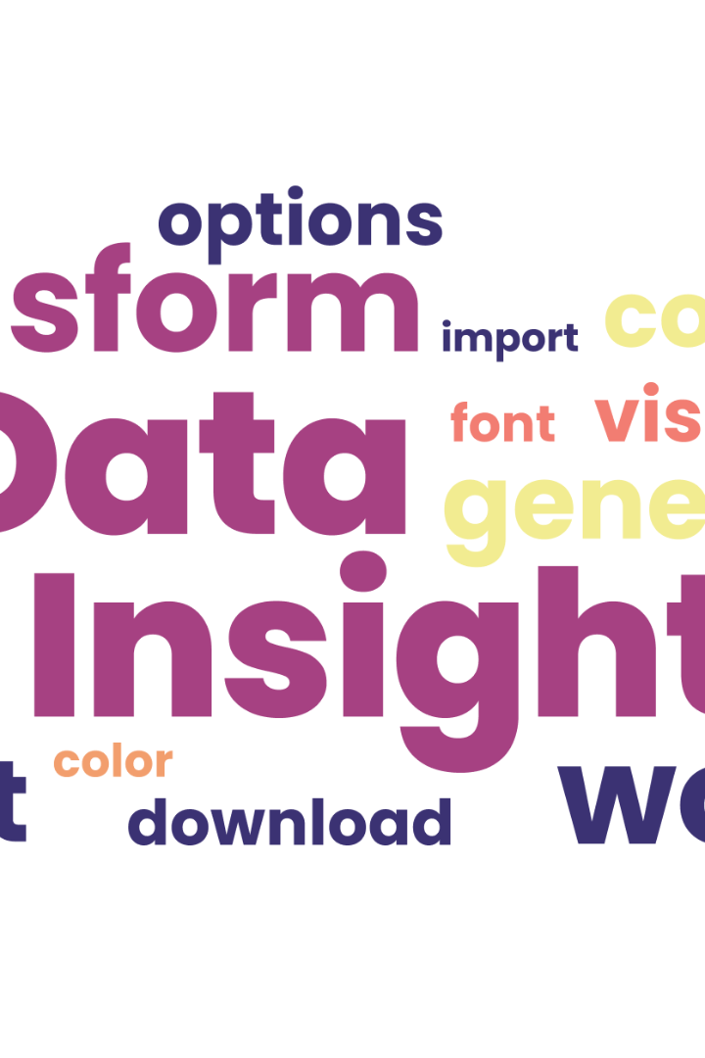
Text Processing For NLP Frequency Distribution
Frequency distribution is a powerful tool in NLP that helps us understand the importance and distribution of words in a text. In this presentation, we will explore the significance, methodology, challenges, and applications of frequency distribution.

Slide 2
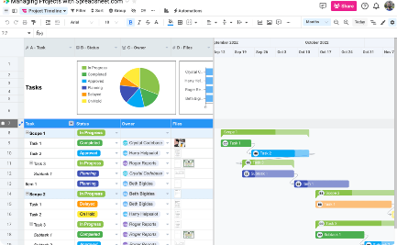
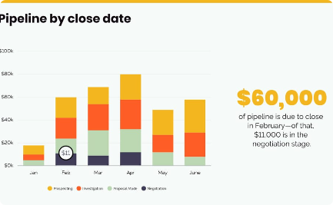

What is Frequency Distribution?
Definition
Visualization
Importance
Frequency distribution is a technique for measuring and analyzing the occurrence of words or phrases in a given text.
It is often represented using a graph, such as a bar chart or a histogram, to help identify patterns and trends in the data.
Frequency distribution is a fundamental tool in natural language processing (NLP) that helps us understand the characteristics of a text and how it can be analyzed.

Slide 3
Methodology of Frequency Distribution
Counting Words
N-Grams
The basic methodology of frequency distribution involves counting the number of times each word or phrase appears in a text.
Frequency distribution can be extended to n-grams, which are sequences of n items (usually words) that appear consecutively in the text.
Normalization
Analysis
The raw frequency counts can be normalized to account for different text lengths and statistical significance, such as by using the TF-IDF technique.
The frequency distribution data can then be analyzed and visualized to identify patterns, trends, and outliers, and used to derive insights about the text.

Slide 4


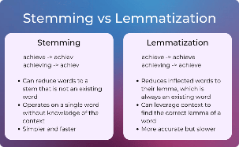
Tokenization for Frequency Distribution
Tokens
Stop Words
Stemming
Lemmatization
In frequency distribution, we first need to divide the text into individual tokens, which are usually words or punctuation marks.
We may also need to remove stop words, which are common words that do not carry much meaning, such as "the", "a", and "of".
Stemming can be used to reduce words to their base form, such as by removing suffixes and prefixes, to count similar words as one.
Lemmatization can be used to further reduce words to their canonical form, such as by converting nouns to their singular form, to improve accuracy.

Slide 5
Case Sensitivity in Frequency Distribution
Case sensitivity refers to whether text processing distinguishes between uppercase and lowercase letters in words.
In frequency distribution analysis, case sensitivity impacts the accuracy of word counts and representations.
Case-insensitive analysis treats words with different capitalization forms (e.g., "apple" and "Apple") as the same entity.
Case sensitivity choice should align with analysis goals; some applications require case-sensitive treatment to capture proper nouns or emphasis, while others opt for case-insensitive to standardize counts.

Slide 6
Frequency Distribution for Language Analysis
Topic Modeling
Frequency distribution can be used to identify the most frequent words and topics in a text, and cluster the text into related groups.
1
2
3
Sentiment Analysis
Named Entity Recognition
Frequency distribution can be used to identify the most frequent positive and negative words in a text and derive its overall sentiment.
Frequency distribution can be used to identify the most frequent named entities, such as people, locations, and organizations, in a text.

Slide 7
Sentiment Analysis
Leveraging Text Emotion: Frequency distribution helps identify frequently occurring positive, negative, and neutral words, providing insights into the emotional tone of the text.
Determining Sentiment Polarity: By analyzing word frequencies, sentiment analysis algorithms can classify the sentiment polarity of a text, contributing to automated sentiment assessment.
Contextual Sentiment Insights: Frequency distribution allows us to explore contextually relevant sentiment triggers, enhancing the depth of sentiment analysis.
Fine-tuning Sentiment Models: Adjusting sentiment models based on word frequency can lead to more accurate sentiment classification for specific domains or languages.

Slide 8
Topic Modelling
Content Clustering: Frequency distribution aids in grouping words related to specific topics, forming the basis for topic clustering and analysis.
Semantic Exploration: Analyzing frequently occurring words in topics helps uncover the underlying semantic themes present in the text data.
Topic-Driven Summarization: Topic modeling with frequency distribution supports topic-driven summarization, allowing us to generate focused and coherent summaries.
Enhanced Understanding: By identifying prevalent words across topics, frequency distribution deepens our understanding of the predominant themes within the text.

Slide 9
Named Entity Recognition
Entity Identification: Frequency distribution assists in recognizing frequently mentioned entities like people, organizations, locations, and dates.
Entity Categorization: Analyzing entity frequencies provides insights into the prominence of different entity categories, guiding the categorization process.
Contextual Entity Significance: Frequency distribution helps determine the significance of named entities in various textual contexts, aiding in information extraction.
Entity-Based Information Extraction: Frequency distribution improves the extraction of specific information associated with named entities, enhancing data enrichment.

Slide 10
Visualization of Frequency Distribution
Bar Chart
Word Cloud
Heatmap
A bar chart is a simple and effective way to visualize the frequency of words in a text.
A word cloud is a popular and visually appealing way to display the most frequent words in a text, using different sizes and colors for different frequencies.
A heatmap is a useful way to visualize the co-occurrence of words in a text, using different colors for different frequency levels.

Slide 11

Applications of Frequency Distribution
1
Marketing
2
E-Commerce
Frequency distribution can be used to identify the most frequently mentioned products, features, and complaints in customer feedback.
Frequency distribution can be used to analyze customer reviews and improve product recommendations and search algorithms.
3
Education
Frequency distribution can be used to analyze and compare the vocabulary and readability of different texts and textbooks, and predict student performance.

Slide 12

Limitations of Frequency Distribution
Frequency distribution, while a valuable analytical tool, does come with certain limitations. These include:
Vocabulary Size: Large vocabularies can lead to sparse frequency distribution tables, potentially omitting less frequent terms that could still be significant.
Context Disregard: Frequency distribution treats words equally without considering their contextual meanings, potentially missing nuances.
Noise from Stop Words: Frequent stop words can dominate the distribution and dilute meaningful insights, requiring careful handling.
Bias in Analysis: Focusing solely on high-frequency terms might overlook contextual understanding and reinforce pre-existing biases.

Slide 13
Future Directions in Frequency Distribution
As technology and language analysis continue to evolve, frequency distribution holds promise for various future directions:
Advanced Semantic Analysis: Integrating semantic analysis techniques can enhance context-aware frequency distribution for more accurate insights.
Cross-Language Analysis: Frequency distribution can be extended to multilingual text, enabling cross-language comparisons and insights.
Contextualized Text Processing: Leveraging contextual embeddings can address the limitations of context disregard, enabling better analysis.
Integration with Machine Learning: Frequency distribution can complement machine learning models, contributing to more robust language processing.

Slide 14


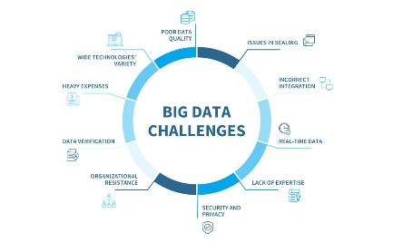
Leveraging Frequency Distribution for Insight
Competitive Analysis
User Behavior
Data Mining
Frequency distribution can be used to analyze and compare the language and communication styles of different companies and industries.
Frequency distribution can be used to analyze the language and behavior patterns of different user segments and personas, and improve user engagement and experience.
Frequency distribution can be used as a basis for more advanced NLP techniques, such as topic modeling, sentiment analysis, and entity recognition.

Slide 15

Conclusion
Frequency distribution is a powerful and versatile tool in NLP that can help us gain insights into language and communication patterns. By understanding the methodology, challenges, and applications of frequency distribution, we can use it to improve our communication, marketing, education, and more. However, we should also be mindful of its limitations and explore new directions to advance the field of NLP.

